Slide 1
Bridging CTM and Land-Use Regression:
A High-Spatial Resolution Approach to Simulate Air Pollution Exposure Disparities Under Major Transportation Policy Scenarios
Authors: Jad Zalzal, Laura Minet, Jeffrey Brook, Cristian Mihele, Hong Chen and Marianne Hatzopoulou
Date: January 6, 2025

Slide 2
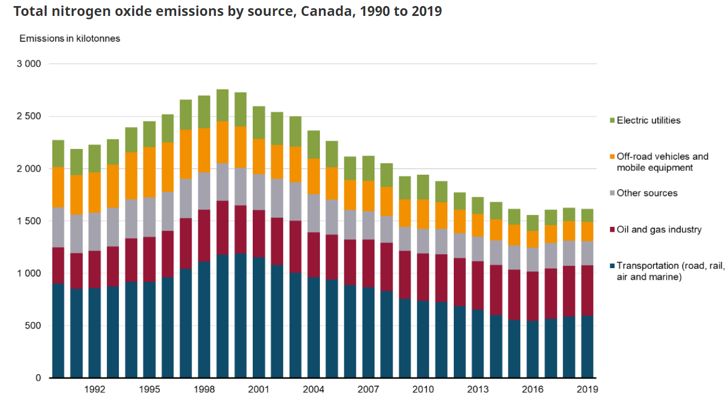
Emissions from the transportation sector
~ 23% of NOx emissions are from on-road transportation
Buses (Mostly diesel fueled)
Cars (Mostly gasoline fueled)
Trucks (Mix of gasoline for light-duty trucks and diesel for medium and heavy-duty trucks)
Slide #2/13

Slide 3
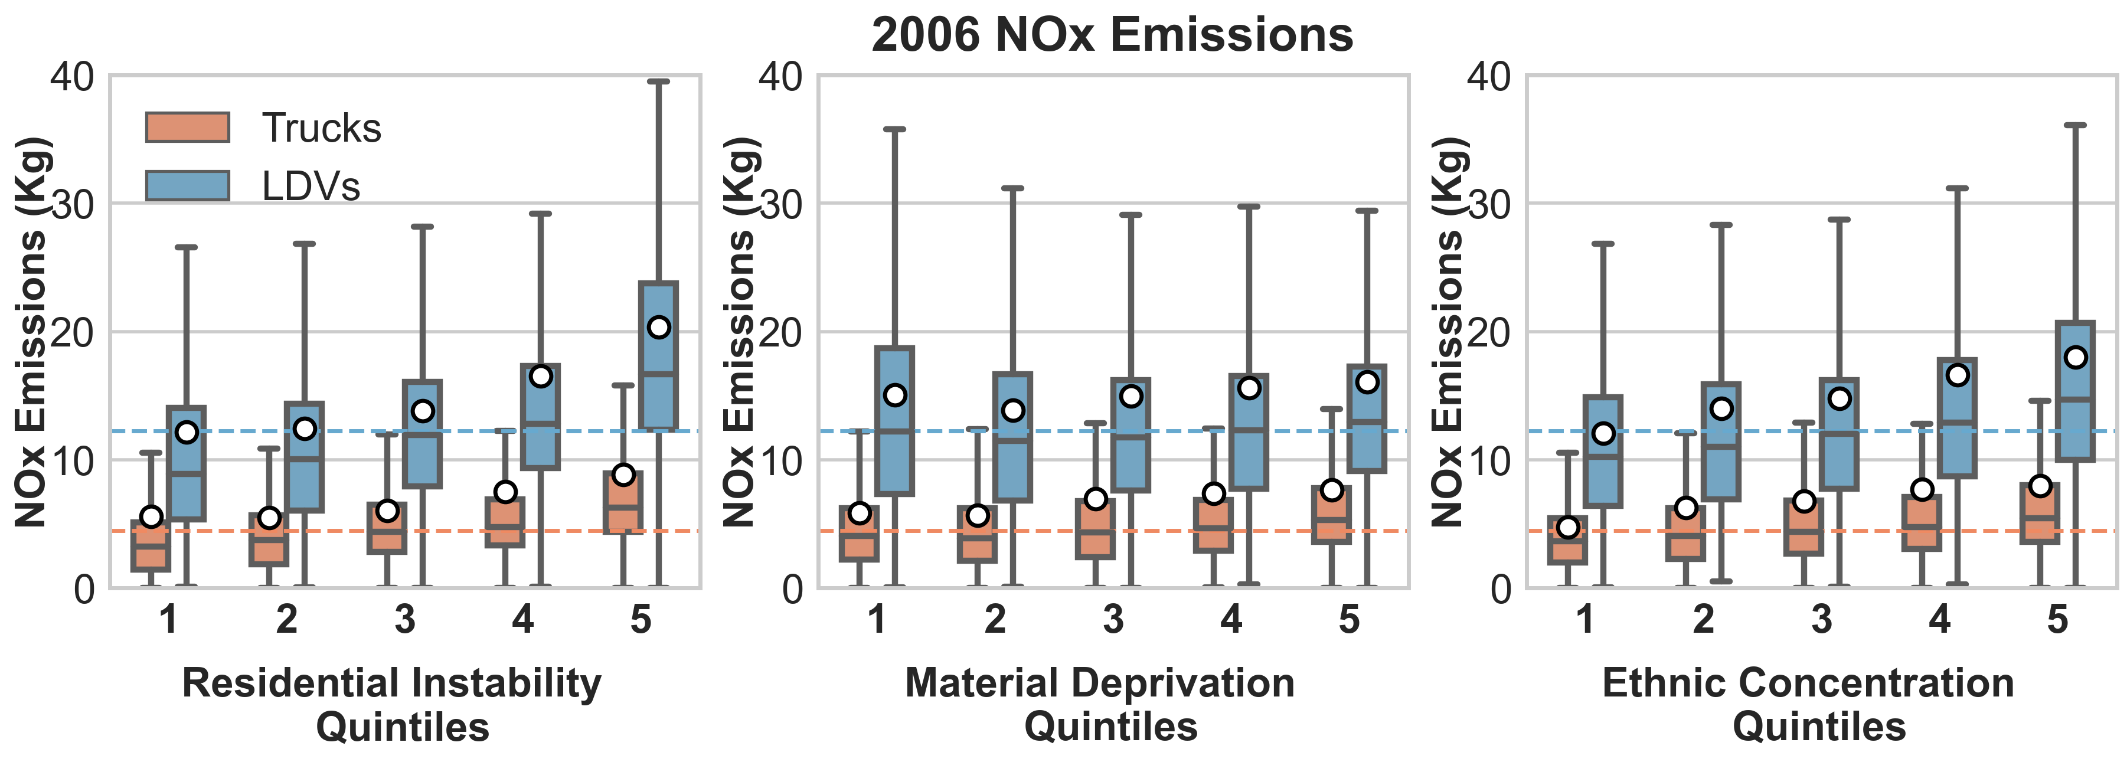
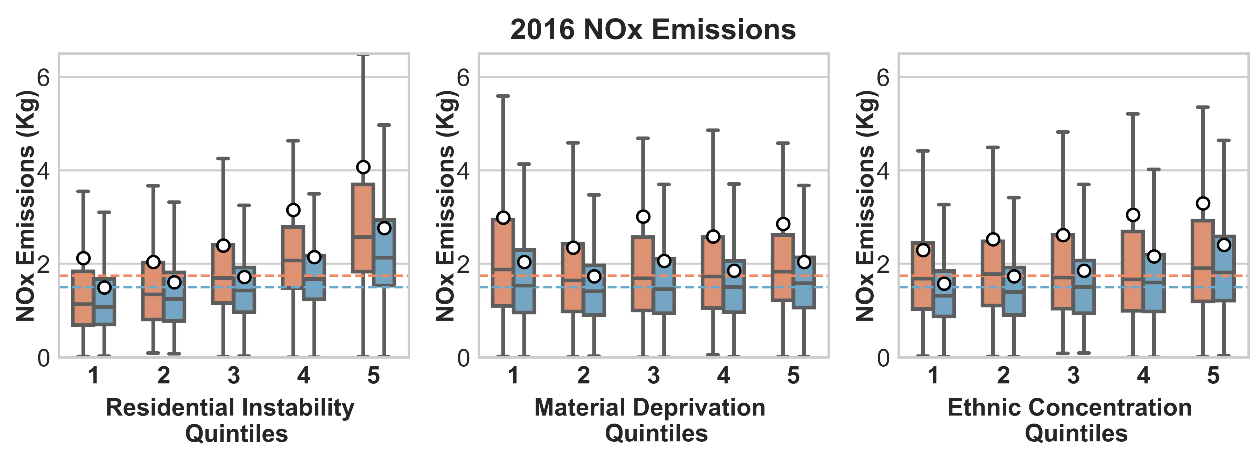
Disparities in exposure to LDV and truck NOx emissions in Toronto
Check out the paper here:
Regions with higher residential instability and higher ethnic concentration had higher emissions from trucks and LDVs
Zalzal, J., & Hatzopoulou, M. (2022). Fifteen Years of Community Exposure to Heavy-Duty Emissions: Capturing Disparities over Space and Time. Environmental Science & Technology, 56(23), 16621-16632.
Slide #3/13

Slide 4
CTMs vs LURs
Chemical Transport Models (CTMs)
vs
Land Use Regression Models (LURs)
Suitable for simulating emission scenarios
High-spatial resolution and can capture intra-urban variability
Cannot be used to simulate emission scenarios
Coarse spatial resolution
Previous studies have shown that coarser resolution tends to underestimate disparities in exposure to air pollution
Slide #4/13

Slide 5
Objectives
Objective 1: Model the impact of transportation emissions scenarios at a high-spatial resolution (~100m) by downscaling CTMs
Objective 2: Assess the burden of buses, cars and trucks on disparities in exposure to NO₂ in the Greater Toronto Area
Objective 3: Determine the impact of spatial resolution and model used (LUR vs CTM) on exposure and environmental justice analyses
Slide #5/13

Slide 6
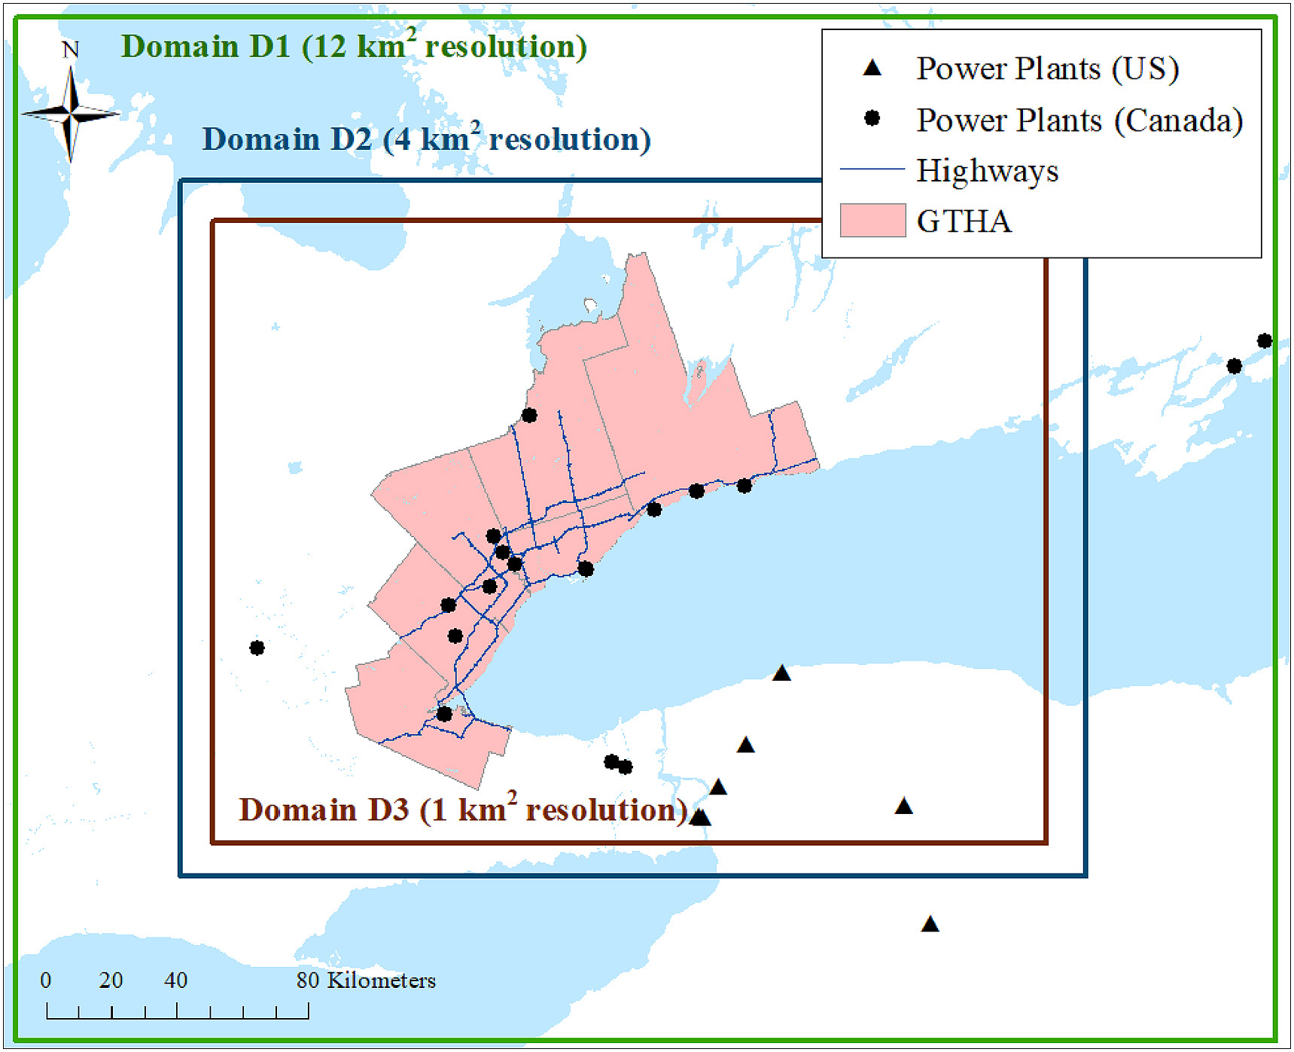
Mobile measurements and CTM simulation
Mobile monitoring campaign (Shairsingh et al. 2019)
CTM simulations
(Minet et al. 2020)
Polair3D CTM was run over 3 nested domains of 12km², 4km² and 1km² resolutions for the months of May and November 2016
Mobile NO₂ measurements collected on 30 days during the months of July and September 2015 and during January 2016 in the Greater Toronto Area (GTA)
Slide #6/13

Slide 7
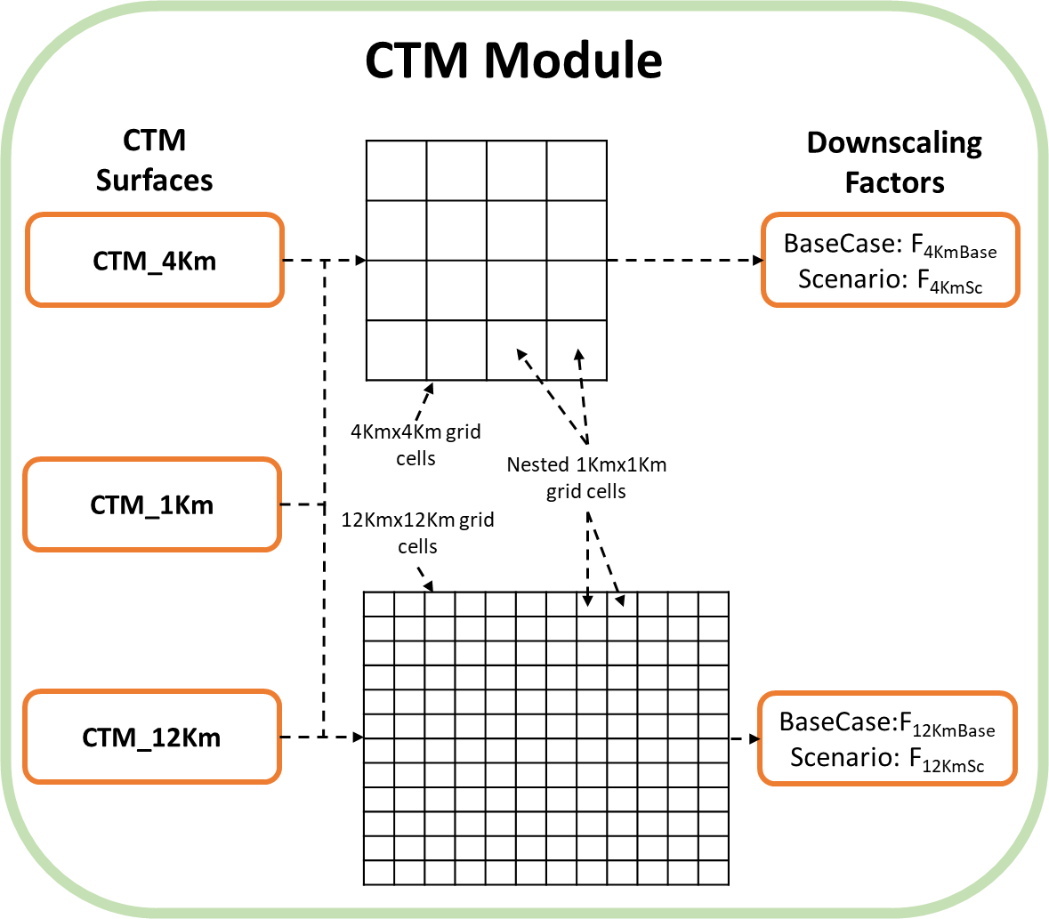
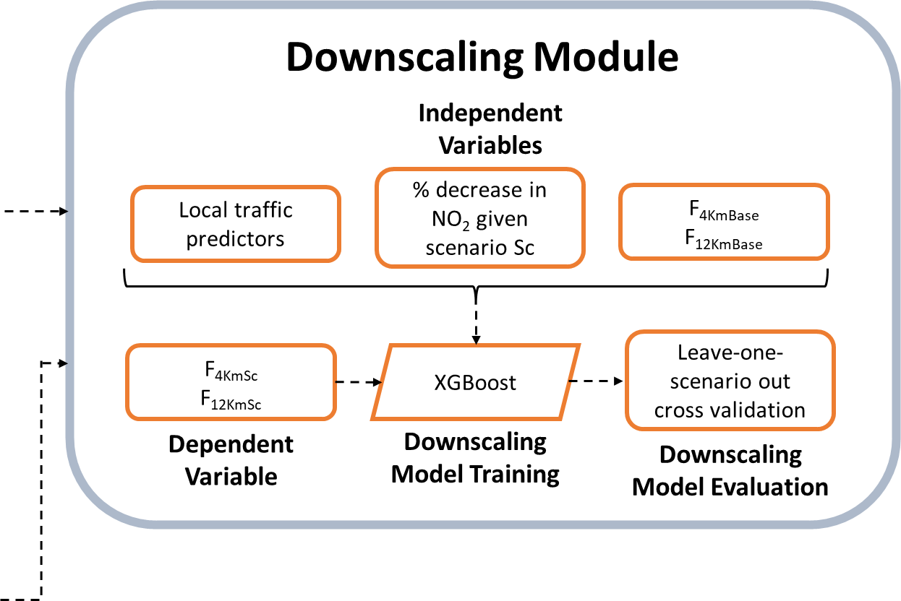
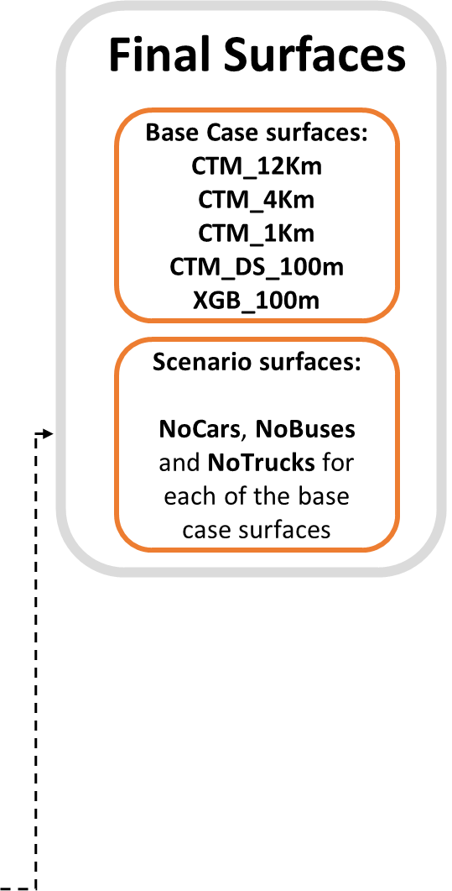
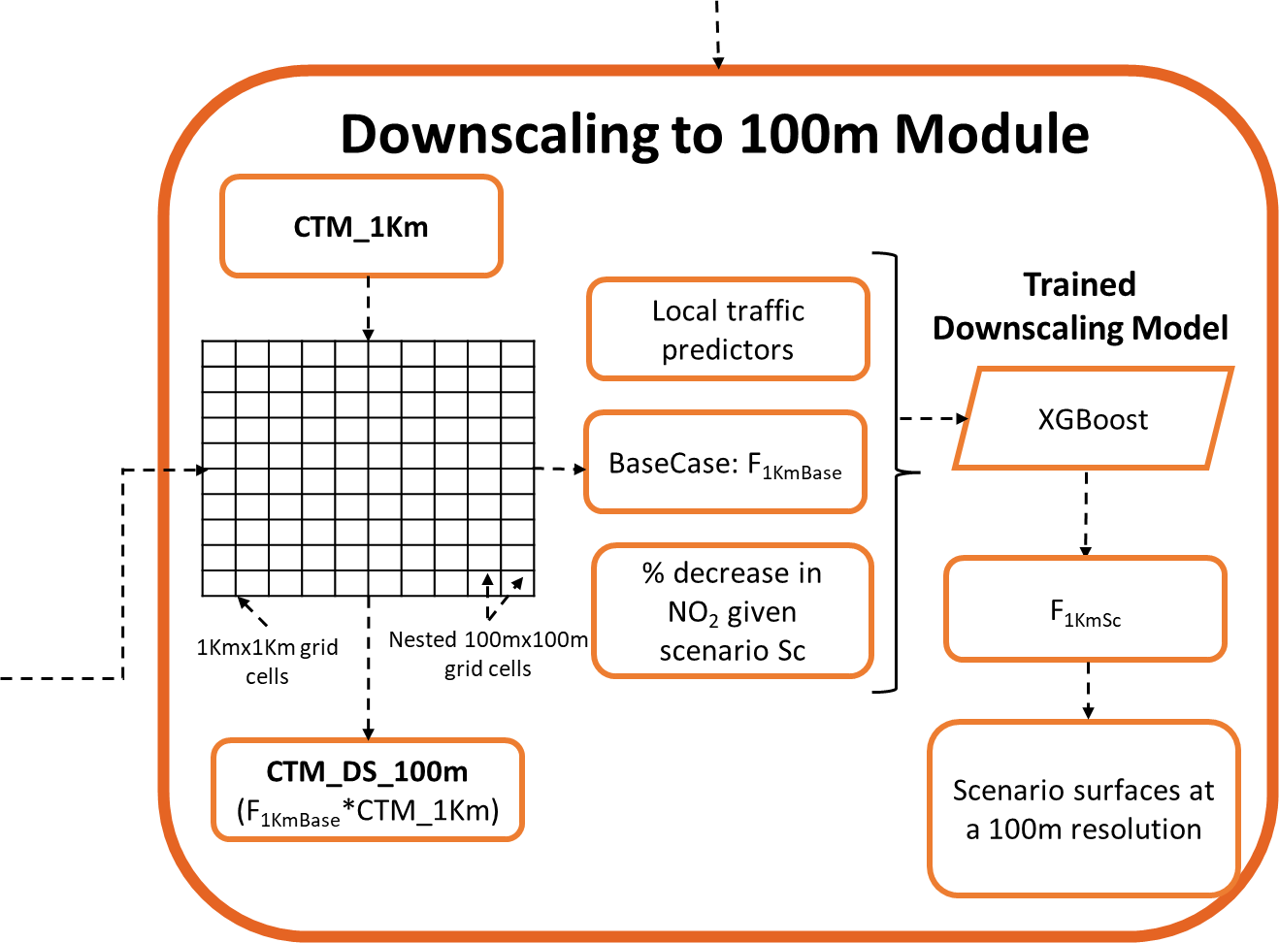
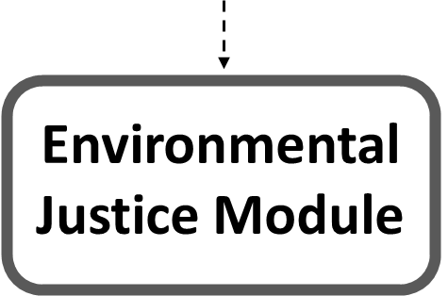
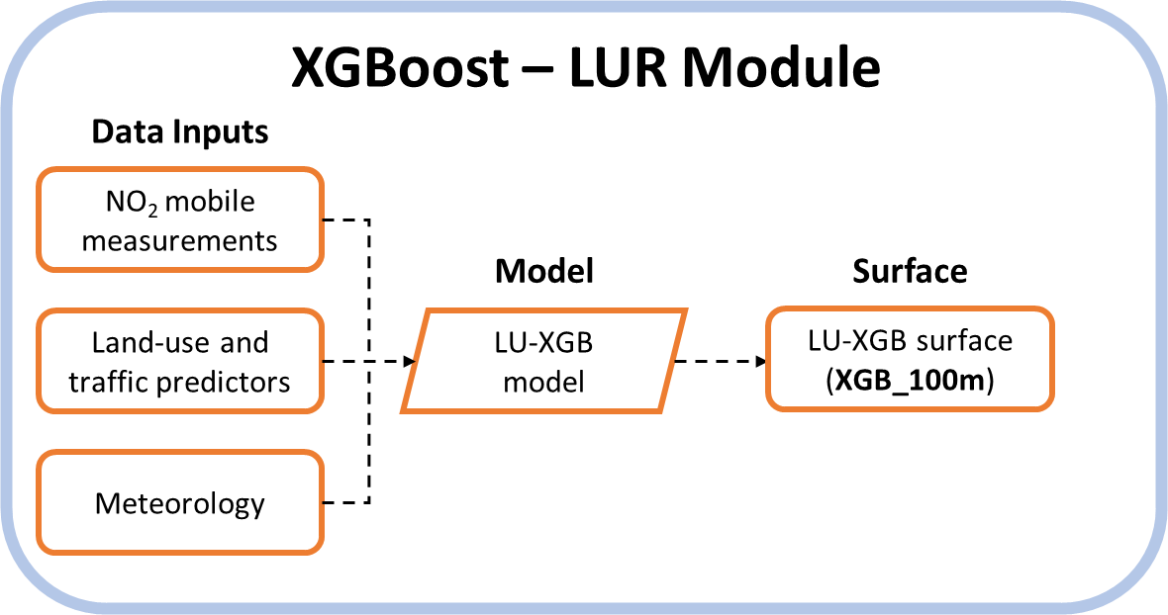
Downscaling model
Combine CTMs and LURs for the purpose of downscaling CTM simulations under different scenarios
Slide #7/13

Slide 8
Downscaling model
The updated downscaling factors resulted in larger decreases near major roads compared to using base case factors
Slide #8/13

Slide 9
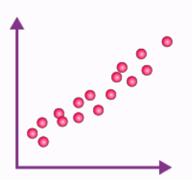
Base case surfaces
High-spatial resolution surfaces necessary to capture intra-urban variability
R²=0.24
R²=0.19
R²=0.27
NAPS NO₂ concentrations
LUR-based surface performed better than CTMs
NO₂ surface
R²=0.49
R²=0.73
Slide #9/13

Slide 10
Contributions of different fleets to NO₂ exposure
~6% of total NO₂ exposure
~12% of total NO₂ exposure
~14% of total NO₂ exposure
Bus burden
Car burden
Truck burden
Slide #10/13

Slide 11
Disparities in exposure to NO₂
Renters, recent immigrants, visible minorities and low-income populations are exposed to higher levels of NO₂
$Disparity=\frac{1}{N_{5}}∗\sum_{i=1}^{N_{5}}{{Conc}_{5thQuintile i}}−\frac{1}{N_{1}}∗\sum_{j=1}^{N_{1}}{{Conc}_{1stQuintile j}}$
Coarse spatial resolutions underestimate disparities
Need for comprehensive policies simultaneously targeting emissions and spatial patterns of the three fleets for better EJ outcomes
Slide #11/13

Slide 12
Summary & Conclusions
Exposure surfaces:
High-spatial resolution surfaces performed better when compared with measurements at reference stations
Machine learning based LUR performed better than the CTM at all spatial resolutions
Statistically combining LURs and CTMs could be useful for generating high-resolution exposure surfaces under different scenarios
Environmental Justice:
Renters, recent immigrants, visible minorities and low-income populations are exposed to higher levels of NO₂
Reductions in emissions from a single vehicle fleet result in a reduction in disparities but are not sufficient to eliminate them
Coarser spatial resolution tended to underestimate disparities in exposure
Slide #12/13

Slide 13
Check out the paper here
Let’s connect on LinkedIn!
Thank you!
Email: jad.zalzal@mail.utoronto.ca

